Slide 1

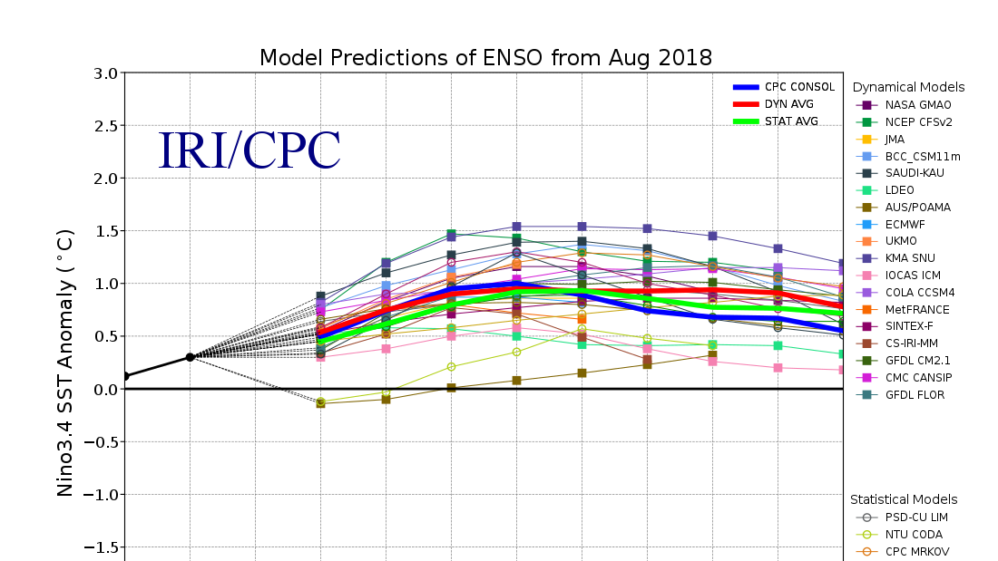
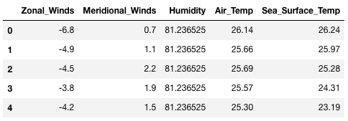
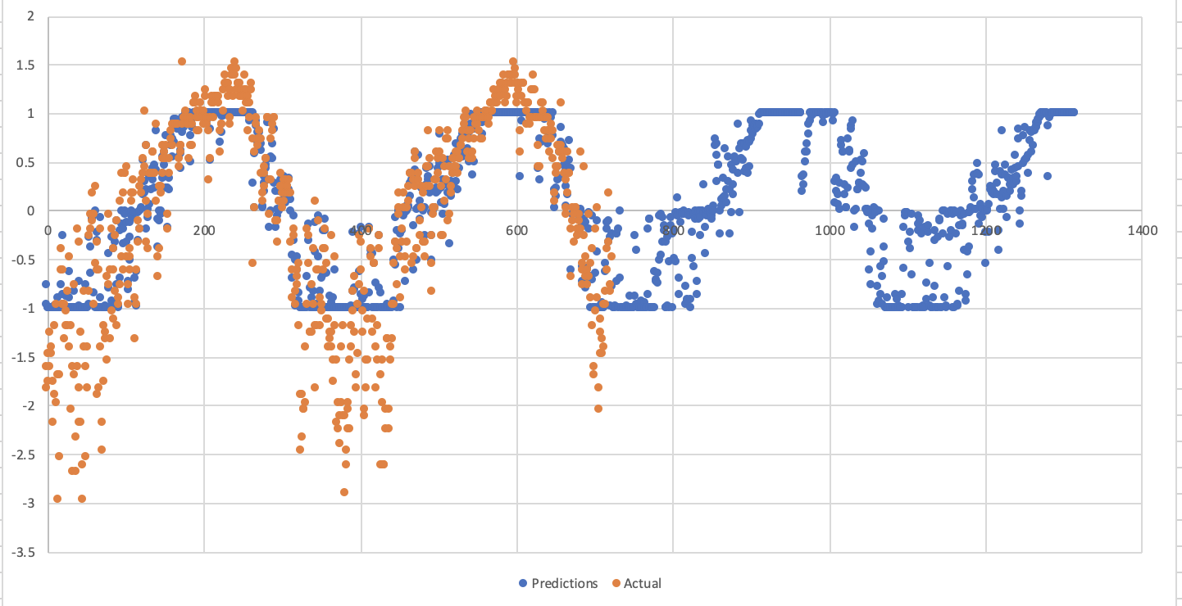

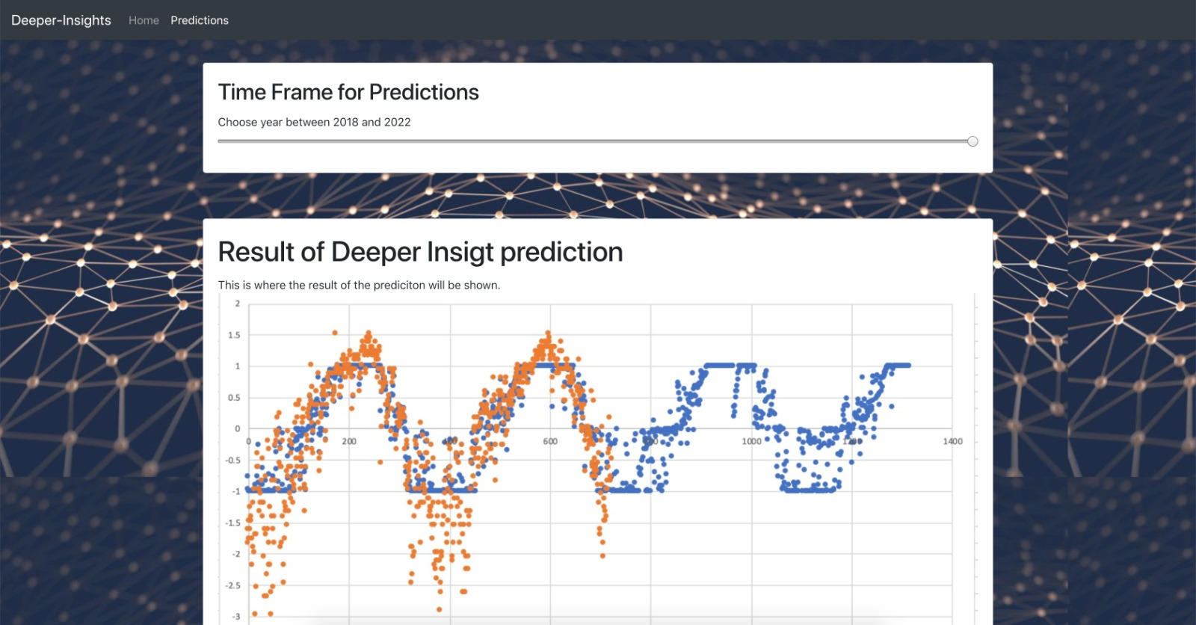
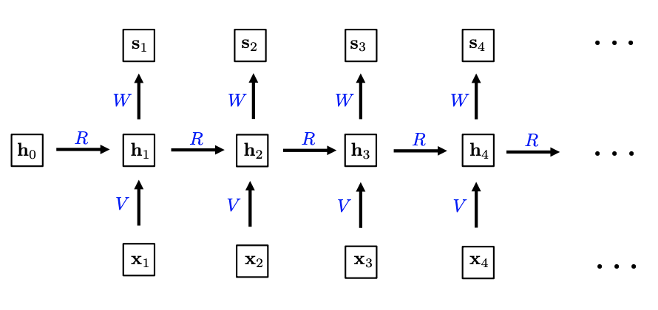














Deeper Insights: Developing a Deep Learning Algorithm for Climate Change Prediction
Natalia Dibbern and Juan Neri | Department of Computer Science| Loyola Marymount University
The Climate Change Prediction Problem
The Data
The Prediction Results
According to the Department of Civil Engineering and Environmental Sciences at Loyola Marymount University, climate change projections continue to be dominated by large uncertainties.
Complex dynamic models
Outdated statistical models
Computationally inefficient “ensemble methods”
-6.8
0.7
81.2
26.1
26.2
-4.9
1.1
81.2
25.7
26.0
-4.5
2.2
81.2
25.7
25.3
-3.8
1.9
81.2
25.6
24.3
-4.2
1.5
81.2
25.3
23.2
$$x_{0}=$$
$$x_{1}=$$
$$x_{2}=$$
$$x_{3}=$$
$$x_{4}=$$
Fig 4: Algorithm's Input features
Fig 5: Mean sea surface level temperature as a function of time
Fig 1: Current statistical models used to predict El Niño
The Solution
The User Interface (UI)
Recent research in the field of Artificial Intelligence has provided advances in such topics as:
Deep Learning Algorithms
High quality data
Cloud computing
These advances have increased the likelihood of major breakthroughs in solving climate prediction problems.
The Algorithm
Fig 6: Screen shot of the “about page”
Fig 7: Screen shot of the “predictions page”
The UI is composed of two main web pages:
The algorithm is composed of a Long Short-Term Memory Neural Network given that our data represents an evolution of a system in time.
About Page
Problem
Solution
Challenges
Predictions Page
Time input query form
Algorithm predictions
The Technologies
Fig 2: Visual Representation of the LSTM network
Fig 3: Visualization of a Machine Learning Algorithm’s Pipeline

